Slide 1
Performance metrics

Slide 2
Performance metrics
Continuous
Classification
Correlation
Agreement (non-parametric)
Errors and error models

Slide 3
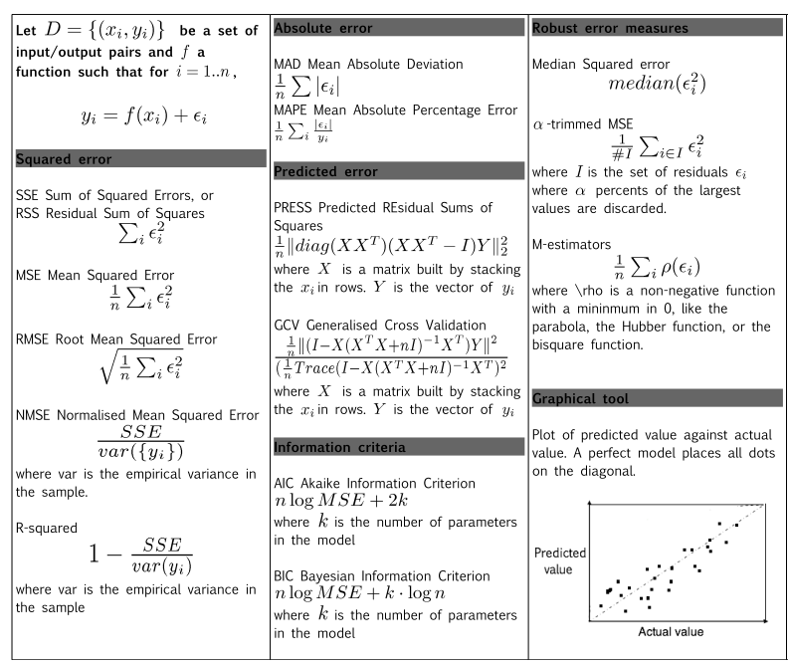
Notes:
Binary classification performances measure cheat sheet
Damien François – v1.1 - 2009 (damien.francois@uclouvain.be)

Slide 4
A Few Confusion Matrix-Based Performance Measures
Accuracy = (TP+TN)/(P+N)
Precision = TP/(TP+FP)
Recall/TP rate = TP/P
FP Rate = FP/N
ROC Analysis moves the threshold between the positive and negative class from a small FP rate to a large one. It plots the value of the Recall against that of the FP Rate at each FP Rate considered.
True class → Hypothesized | class V | Pos | Neg
Yes | TP | FP
No | FN | TN
 | P=TP+FN | N=FP+TN
A Confusion Matrix
Notes:
Performance Evaluation for Learning Algorithms Nathalie Japkowicz
The slides of the tutorial presentation given at Canadian AI 2016
http://www.site.uottawa.ca/~nat/#Tutorials

Slide 5
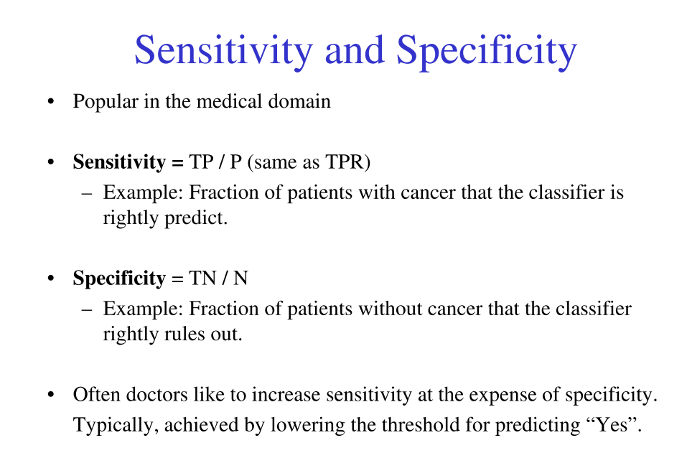
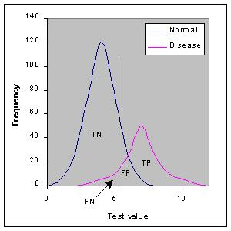

Slide 6
Issues with Accuracy
True class → | Pos | Neg
Yes | 200 | 100
No | 300 | 400
 | P=500 | N=500
True class → | Pos | Neg
Yes | 400 | 300
No | 100 | 200
 | P=500 | N=500
Both classifiers obtain 60% accuracy
They exhibit very different behaviours:
On the left: weak positive recognition rate/strong negative recognition rate
On the right: strong positive recognition rate/weak negative recognition rate
Notes:
Performance Evaluation for Learning Algorithms Nathalie Japkowicz
The slides of the tutorial presentation given at Canadian AI 2016
http://www.site.uottawa.ca/~nat/#Tutorials

Slide 7
Issues with Precision/Recall
True class → | Pos | Neg
Yes | 200 | 100
No | 300 | 400
 | P=500 | N=500
True class → | Pos | Neg
Yes | 200 | 100
No | 300 | 0
 | P=500 | N=100
Both classifiers obtain the same precision and recall values of 66.7% and 40% (Note: the data sets are different)
They exhibit very different behaviours:
Same positive recognition rate
Extremely different negative recognition rate: strong on the left / nil on the right
Note: Accuracy has no problem catching this!
7
Notes:
Performance Evaluation for Learning Algorithms Nathalie Japkowicz
The slides of the tutorial presentation given at Canadian AI 2016
http://www.site.uottawa.ca/~nat/#Tutorials

Slide 8
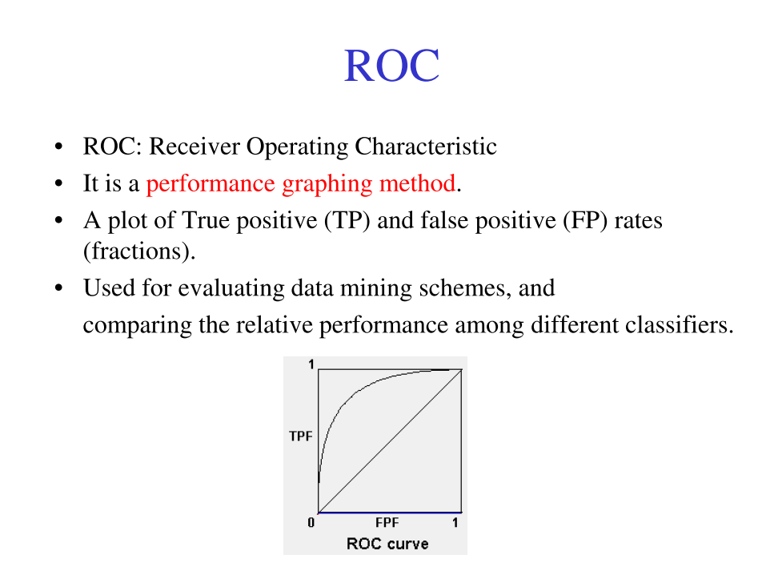

Slide 9
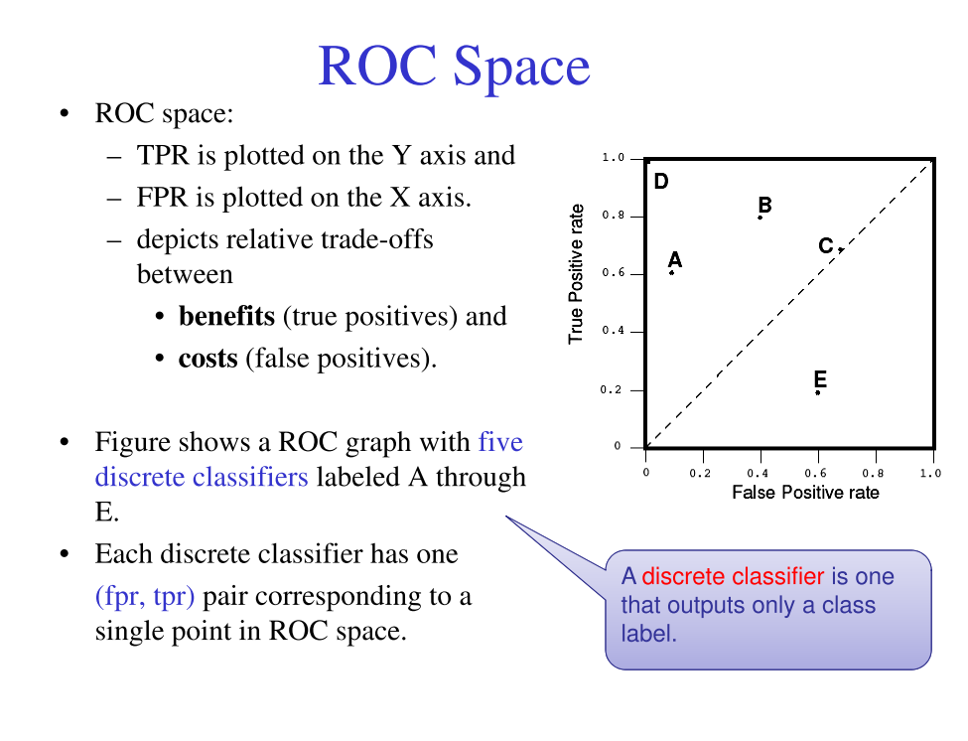

Slide 10
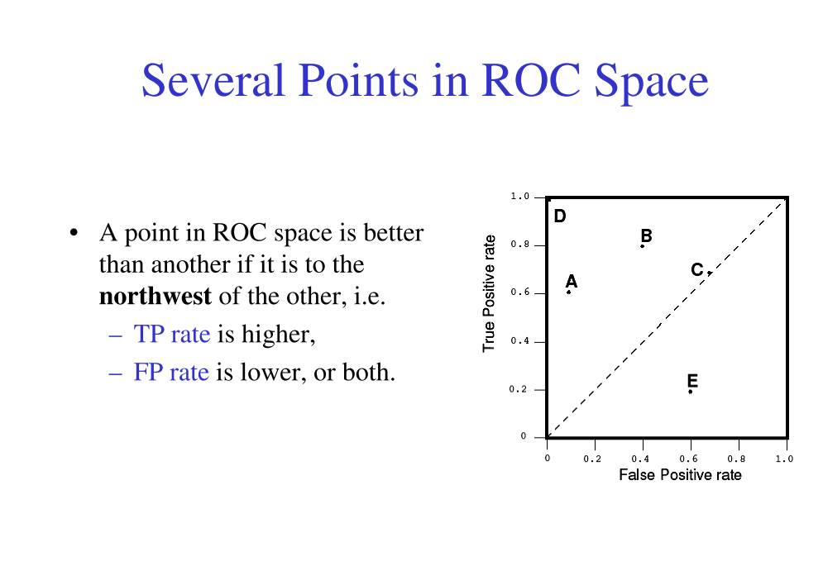
Any classifier that appears in the lower right triangle performs worse than random guessing.

Slide 11
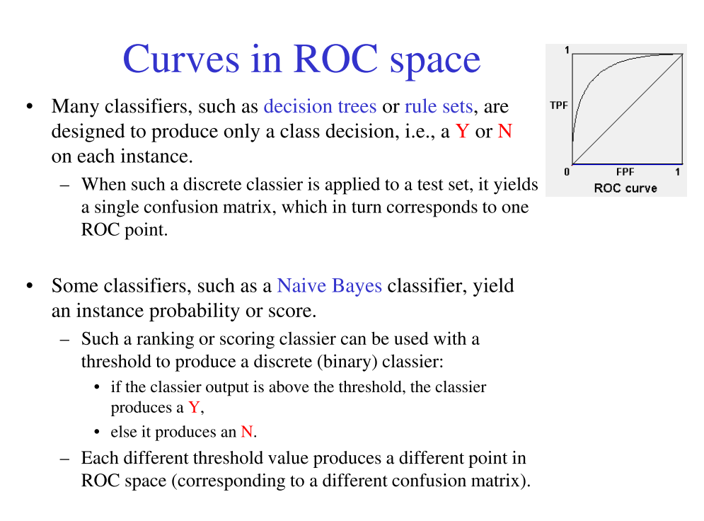

Slide 12
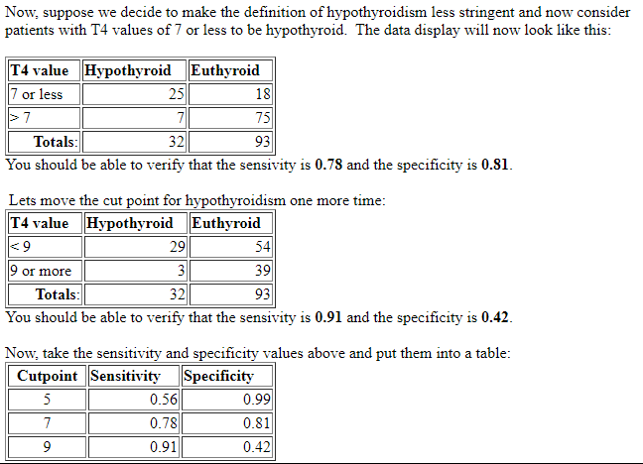
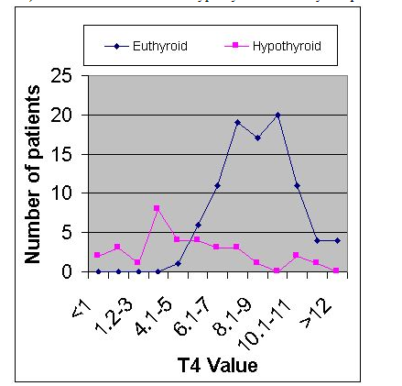
Example
Notes:
We can use the hypothyroidism data from the likelihood ratio section to illustrate how sensitivity and specificity change depending on the choice of T4 level that defines hypothyroidism. Recall the data on patients with suspected hypothyroidism reported by Goldstein and Mushlin (J Gen Intern Med 1987;2:20-24.). The data on T4 values in hypothyroid and euthyroid patients are shown graphically (below left) and in a simplified tabular form (below right).
http://gim.unmc.edu/dxtests/roc2.htm

Slide 13
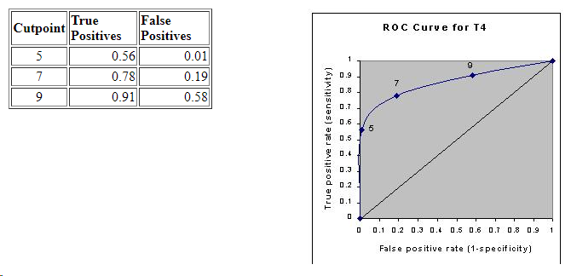
Example continued
Accuracy is measured by the area under the ROC curve. An area of 1 represents a perfect test; an area of .
.90-1 = excellent (A)
.80-.90 = good (B)
.70-.80 = fair (C)
.60-.70 = poor (D)
.50-.60 = fail (F)
Notes:
http://gim.unmc.edu/dxtests/roc2.htm

Slide 14
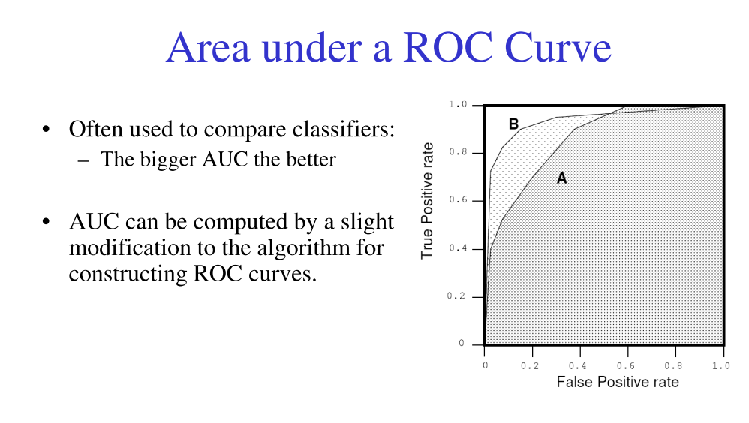

Slide 15
Is the AUC the answer?
Many researchers have now adopted the AUC (the area under the ROC Curve).
The principal advantage of the AUC is that it is more robust than Accuracy in class imbalanced situations.
Indeed, given a 95% imbalance (in favour of the negative class, say), the accuracy of the default classifier that issues “negative” all the time will be 95%, whereas a more interesting classifier that actually deals with the issue, is likely to obtain a worse score.
The AUC takes the class distribution into consideration.
15
Notes:
Performance Evaluation for Learning Algorithms Nathalie Japkowicz
The slides of the tutorial presentation given at Canadian AI 2016
http://www.site.uottawa.ca/~nat/#Tutorials

Slide 16
Correlation and agreement
18.1 - Pearson Correlation Coefficient
18.2 - Spearman Correlation Coefficient
18.3 - Kendall Tau-b Correlation Coefficient
18.4 - Example - Correlation Coefficients
18.5 - Use and Misuse of Correlation Coefficients
18.6 - Concordance Correlation Coefficient for Measuring Agreement
18.7 - Cohen's Kappa Statistic for Measuring Agreement

Slide 17

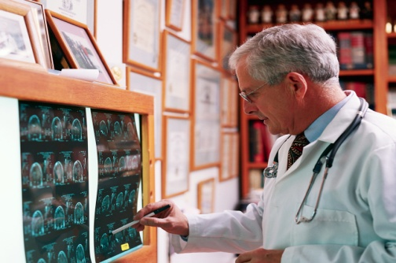
Quantitative Agreement
1) In Science often measurement differs with different ‘raters’
Two radiologists reading same chest x-ray for signs
of pneumoconiosis
Two laboratory scientists counting radioactively marked cells from liver tissue
2) Often same rater differs when measuring the same thing on
a different occasion

Slide 18
Measures of Agreement
Without good agreement results are difficult to interpret
Measurements are unreliable or inconsistent
Need measures of agreement
Mainly two types depending on whether data is 1) continuous or 2) categorical

Slide 19
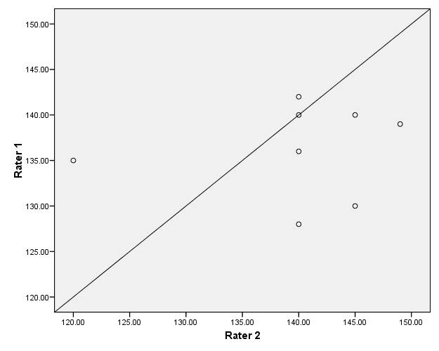
Agreement NOT same as Correlation!
Pearson Correlation r = 0.775
CCC = 0.02
Rater 2

Slide 20
Errors and Bland-Altman:
Measurement Errors Continued
Types of Errors
Assessment of Error
Notes:
Introduction to Study Skills & Research Methods (HL10040)
Dr James Betts
http://people.bath.ac.uk/jb335/Y1%20Research%20Skills%20(FH10040).html

Slide 21
Measurement Errors
Virtually all measurements have errors
i.e.
Measured Score = ‘True’ Score ± Error
Therefore inherently linked to SD
Notes:
Introduction to Study Skills & Research Methods (HL10040)
Dr James Betts
http://people.bath.ac.uk/jb335/Y1%20Research%20Skills%20(FH10040).html

Slide 22
(SD²)
Total
Variance
Systematic
Variance
Caused by systematic error
This total variance can then be ‘partitioned’
Error
Variance
Caused by random error
Notes:
Introduction to Study Skills & Research Methods (HL10040)
Dr James Betts
http://people.bath.ac.uk/jb335/Y1%20Research%20Skills%20(FH10040).html

Slide 23
Types of Errors
Systematic Error
Any variable causing a consistent shift in the mean in a given direction
e.g. Retrospective diet records tend to omit the snacks between meals
Random Error
The fluctuation of scores due to chance
e.g. Innaccurate descriptions of the food consumed
Notes:
Introduction to Study Skills & Research Methods (HL10040)
Dr James Betts
http://people.bath.ac.uk/jb335/Y1%20Research%20Skills%20(FH10040).html

Slide 24
Assessment of Error
Systematic & Random Error
Callipers HydroStat. Difference Mean
10.00 17.00 7.00 13.50
12.00 22.00 10.00 17.00
8.00 14.00 6.00 11.00
11.00 12.00 1.00 11.50
14.00 11.00 -3.00 12.50
18.00 15.00 -3.00 16.50
10.00 21.00 11.00 15.50
9.00 17.00 8.00 13.00
Notes:
Introduction to Study Skills & Research Methods (HL10040)
Dr James Betts
http://people.bath.ac.uk/jb335/Y1%20Research%20Skills%20(FH10040).html

Slide 25
Assessment of Error
Systematic & Random Error
The “Bland-Altman” Plot 3 points of visual assessment:
-Systematic Error: are points evenly distributed about the zero line?
-Random Error: do points deviate greatly from the mean line?
-Nature of error: is the error consistent left-right?
Notes:
Introduction to Study Skills & Research Methods (HL10040)
Dr James Betts
http://people.bath.ac.uk/jb335/Y1%20Research%20Skills%20(FH10040).html

Slide 26
Examples of Bland-Altman Plots
Very Little Systematic Error
Very Little Random Error
Zero
Mean difference
Notes:
Introduction to Study Skills & Research Methods (HL10040)
Dr James Betts
http://people.bath.ac.uk/jb335/Y1%20Research%20Skills%20(FH10040).html

Slide 27
Examples of Bland-Altman Plots
Some Systematic Error
Very Little Random Error
Mean difference
Zero
Notes:
Introduction to Study Skills & Research Methods (HL10040)
Dr James Betts
http://people.bath.ac.uk/jb335/Y1%20Research%20Skills%20(FH10040).html

Slide 28
Examples of Bland-Altman Plots
Very Little Systematic Error
Some Random Error
Zero
Mean difference
Notes:
Introduction to Study Skills & Research Methods (HL10040)
Dr James Betts
http://people.bath.ac.uk/jb335/Y1%20Research%20Skills%20(FH10040).html

Slide 29
Examples of Bland-Altman Plots
Mean difference
Some Systematic Error
Some Random Error
Zero
Notes:
Introduction to Study Skills & Research Methods (HL10040)
Dr James Betts
http://people.bath.ac.uk/jb335/Y1%20Research%20Skills%20(FH10040).html

Slide 30
Examples of Bland-Altman Plots
Nature of Error:
Funnelling Effect?
Zero
Notes:
Introduction to Study Skills & Research Methods (HL10040)
Dr James Betts
http://people.bath.ac.uk/jb335/Y1%20Research%20Skills%20(FH10040).html

Slide 31
Why is Error Important
Measurement Error is clearly of importance when evaluating the agreement between two measurement tools
A consideration of error is also relevant when attempting to establish intervention effects/treatment differences
i.e. where some of the variance between trials is due to the independent variable...
Notes:
Introduction to Study Skills & Research Methods (HL10040)
Dr James Betts
http://people.bath.ac.uk/jb335/Y1%20Research%20Skills%20(FH10040).html

